Slide 1


Lielahti–Kokemäki project alliance
Outcomes
Mikko A. Heiskanen, Finnish Transport Agency
19.5.2015

Slide 2

Lielahti-Kokemäki project alliance
First public sector project alliance in Europe
Renovation of Tampere−Pori railway, ca. 90 km
Project developement phase and construction phase were executed in less than four years (August 2011–February 2015)
Alliance participants
  Owner participant: Finnish Transport Agency
  Non-owner participant: VR Track
The alliance was responsible for executing all sectors of the project
Total budget of the project is 106,4 M€, which includes
  costs for procurement phase, development phase and delivery phase including materials supplied by the owner
  costs for guarantee period (5 years)
Total budget was set in May 2011, and it includes all the cost level changes of the project and risks

Slide 3
Efficient lead time
Present
^{STRATEGY}
^{FORMING THE ALLIANCE}
^{PROJECT}
^{DEVELOPEMENT PHASE}
^{PROJECT DELIVERY PHASE}
^{CONSTRUCTION}
^{GUARANTEE PERIOD}
1.4.2011
13.8.2011
1.6.2012
13.2.2015
2020

Slide 4
Efficient decision making
ALLIANCE LEADERSHIP TEAM (ALT)
ALLIANCE MANAGEMENT TEAM (AMT)
WORKSHOP TEAMS
CONSTRUCTION TEAM
SPECIALISTS AND CONSTULTANTS
CONSTRUCTION
PLANNING
19.5.2015
4

Slide 5
Collaboration in project management
Traditional procurement
Project schedule
2011
2012
2013
2014
2015
2016
2017
2018
Railway plans
Construction plans
Construction
Commissioning
Alliance procurement
Project schedule
2011
2012
2013
2014
2015
2016
2017
2018
Railway plans
Construction plans
Construction
Commissioning
Total lead time of the project has shortened ca. 2 years

Slide 6
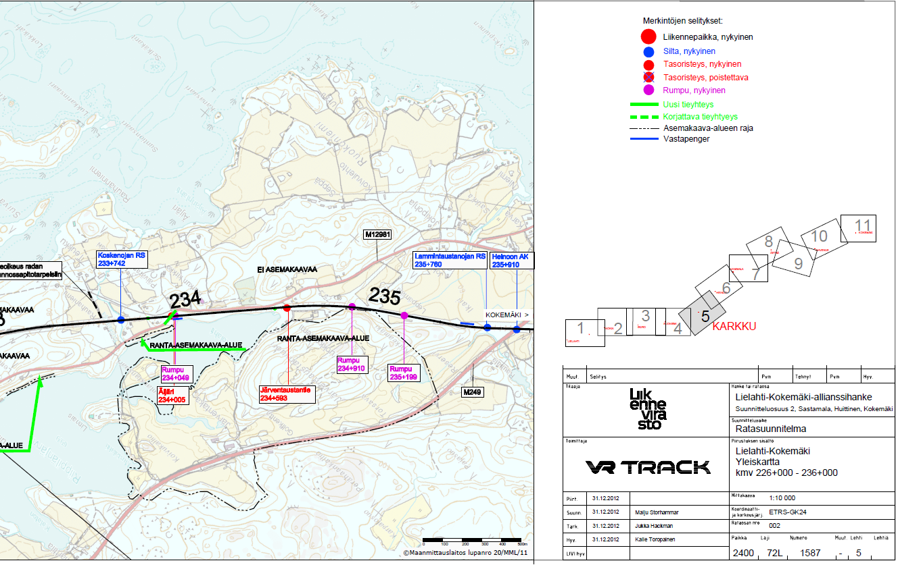
Collaboration between planning and construction

Slide 7
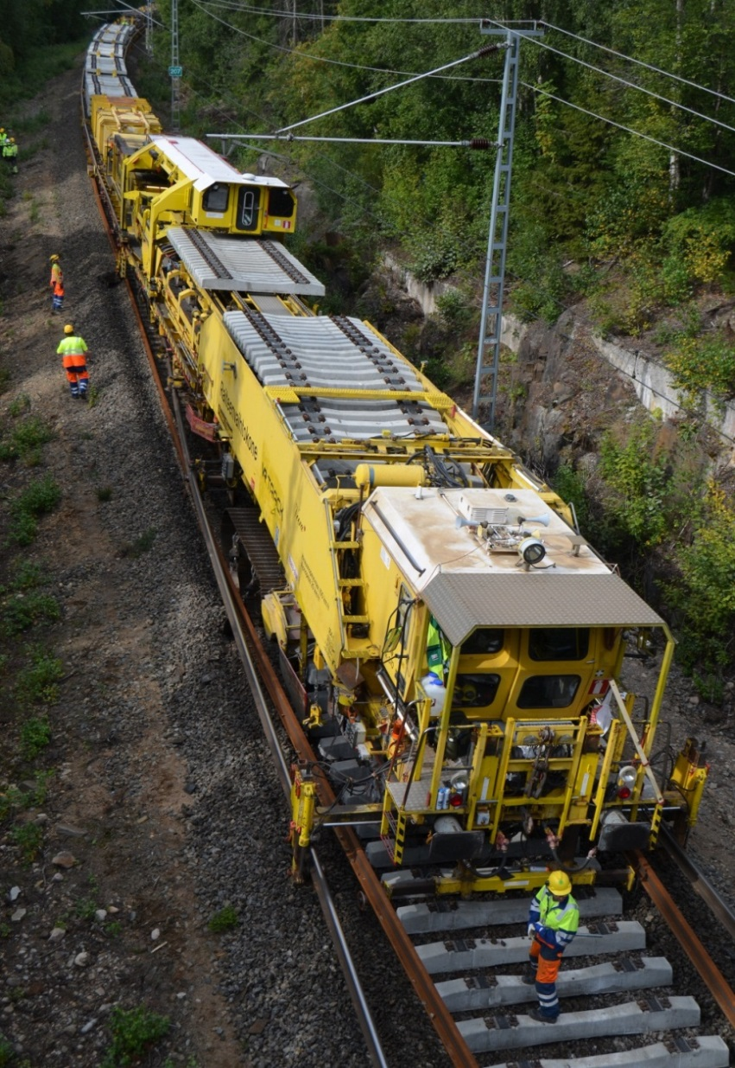
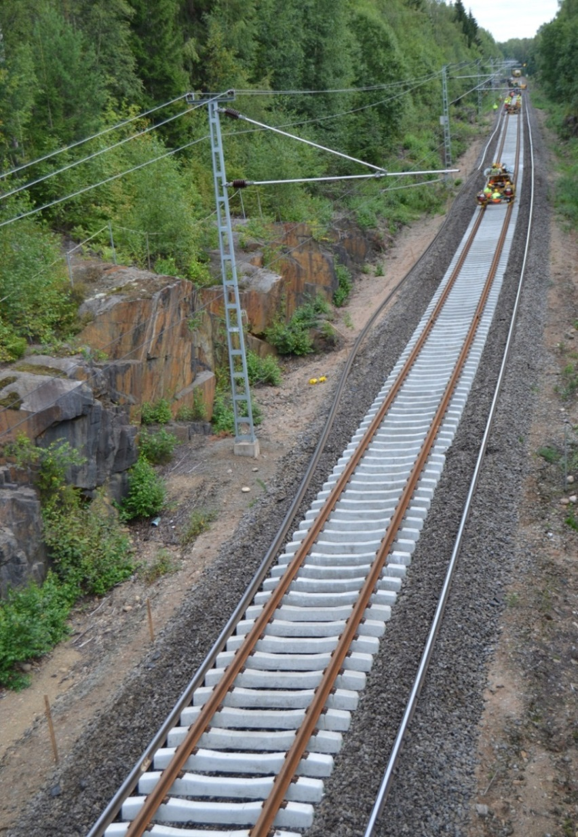
Renewing the track superstructure

Slide 8
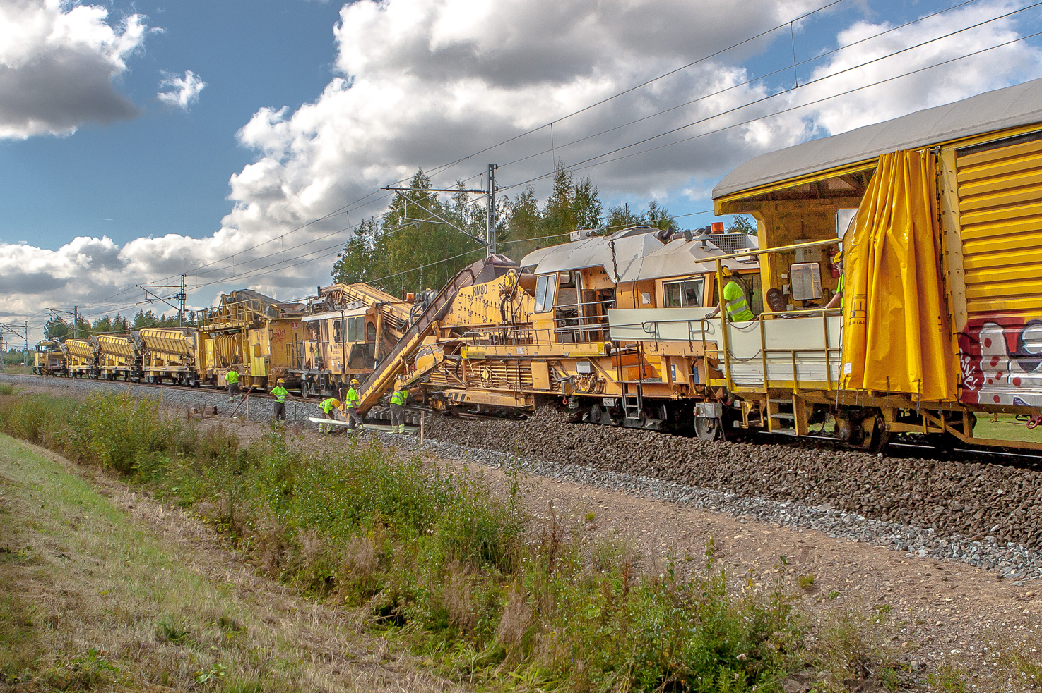
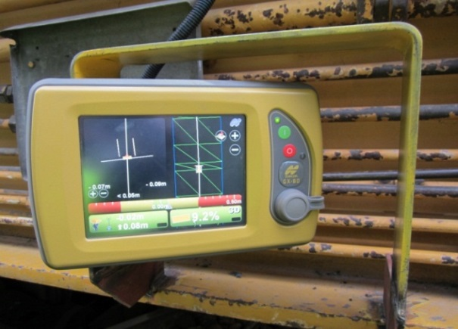
Cleaning the ballast (90 km) and frost insulation (27 km)

Slide 9
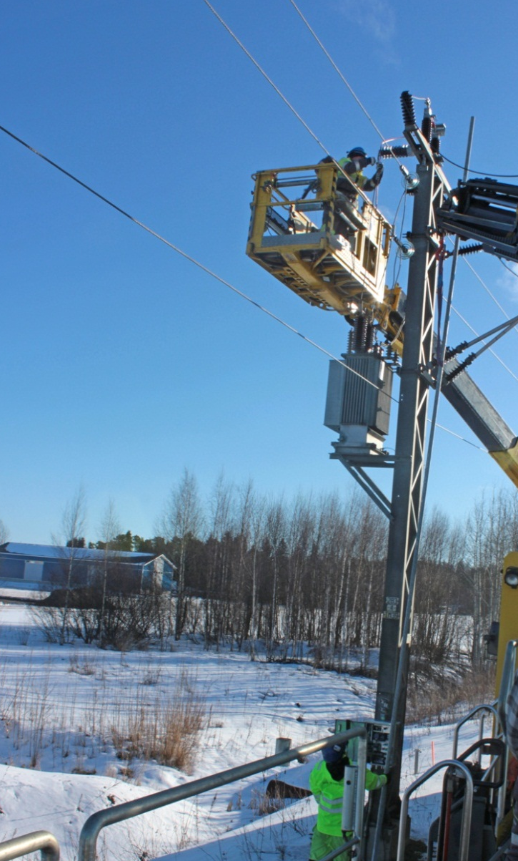
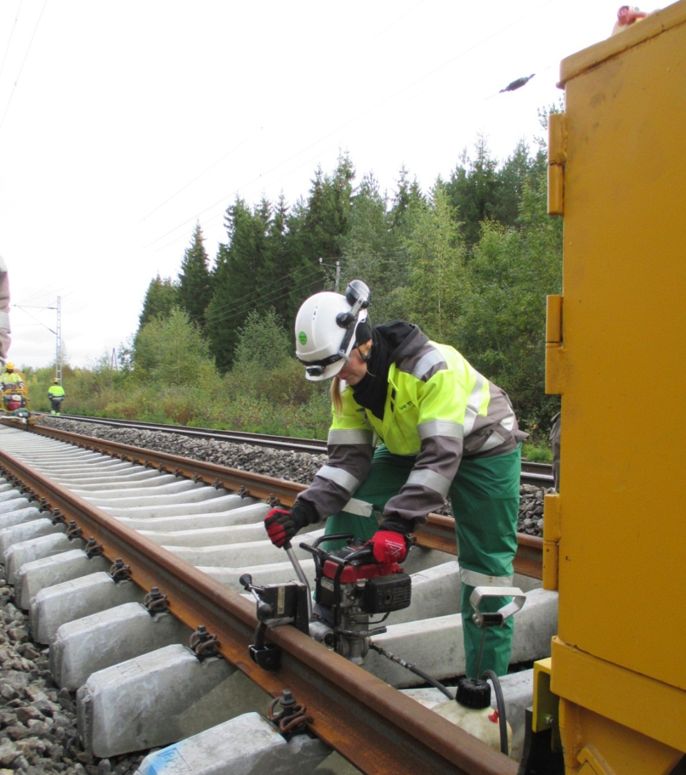
Electricity and signalling works

Slide 10
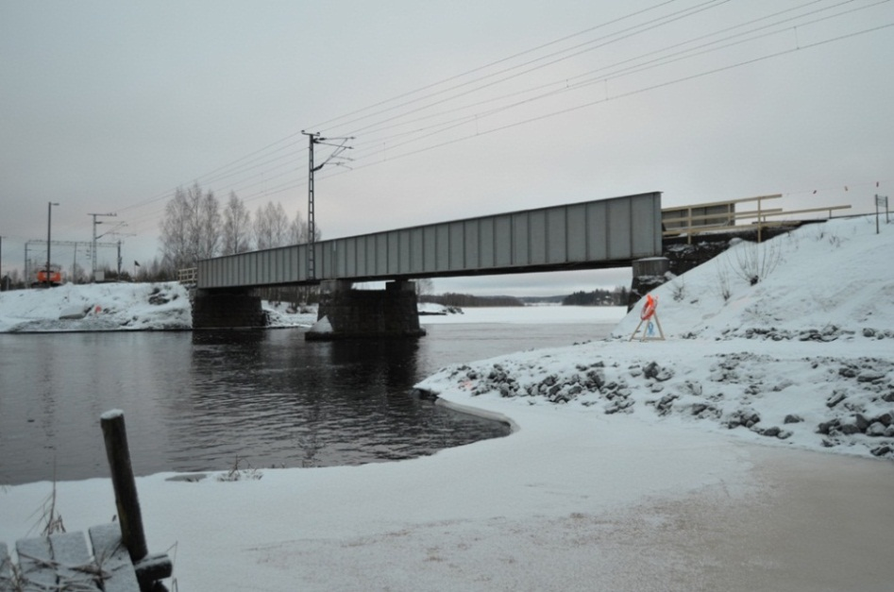
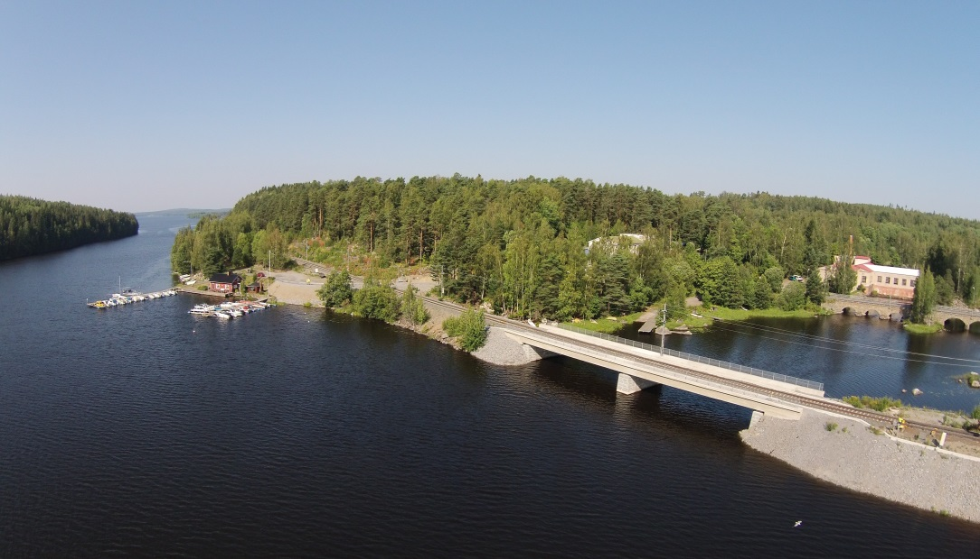
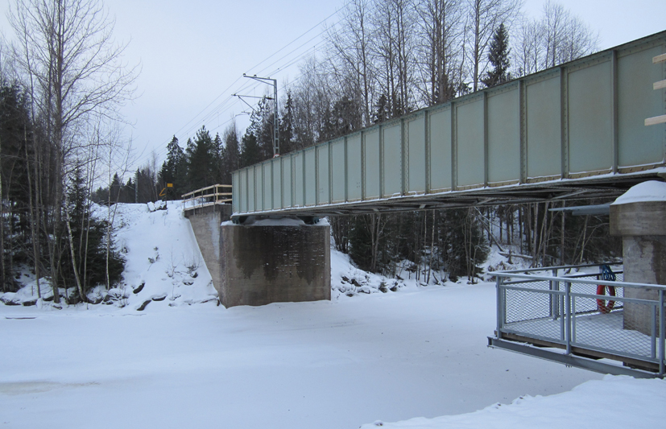
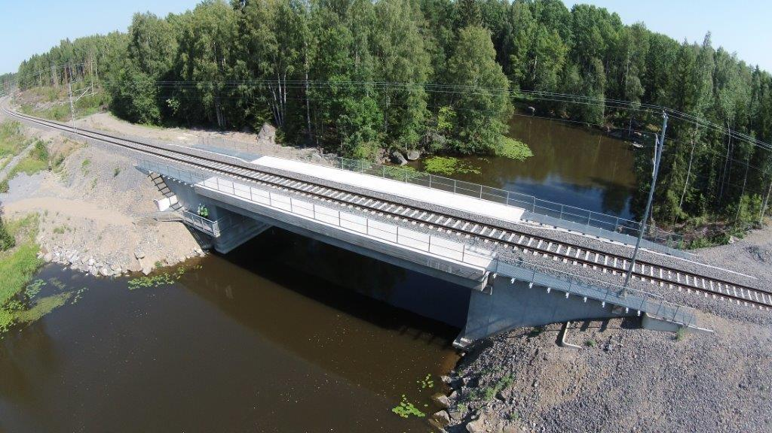
New railway bridges
Siuronkoski bridge before
  …and after
Putajanjoki bridge before
  …and after

Slide 11
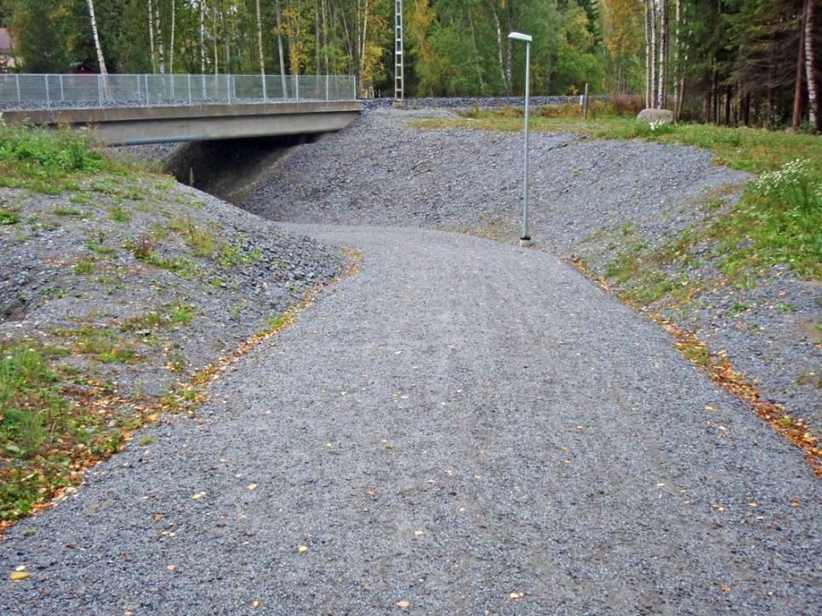
Level crossings
11 removed level crossings
17 upgraded level crossings
Kalkku
4 upgraded level crossings with new boom barriers
Suoniemi
Lielahti
Siuro
Nokia
Karkku
Heinoo
Vammala
Äetsä
Ahvenus
Kokemäki
Significant improvements in both road traffic safety and railroad safety

Slide 12
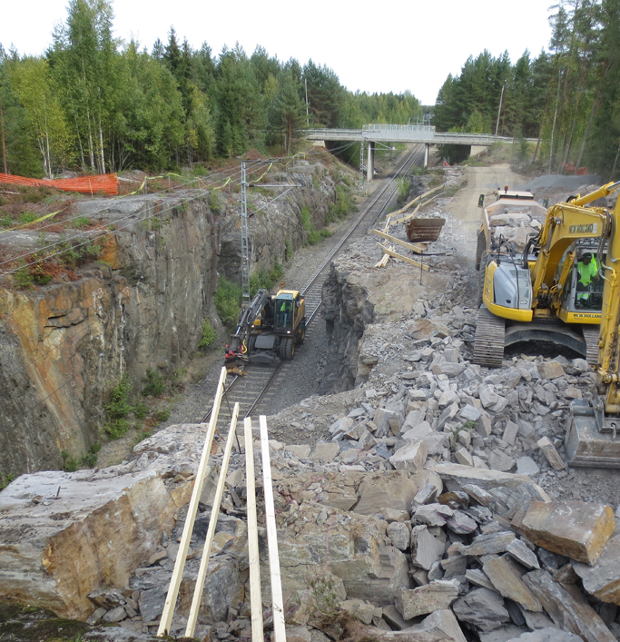
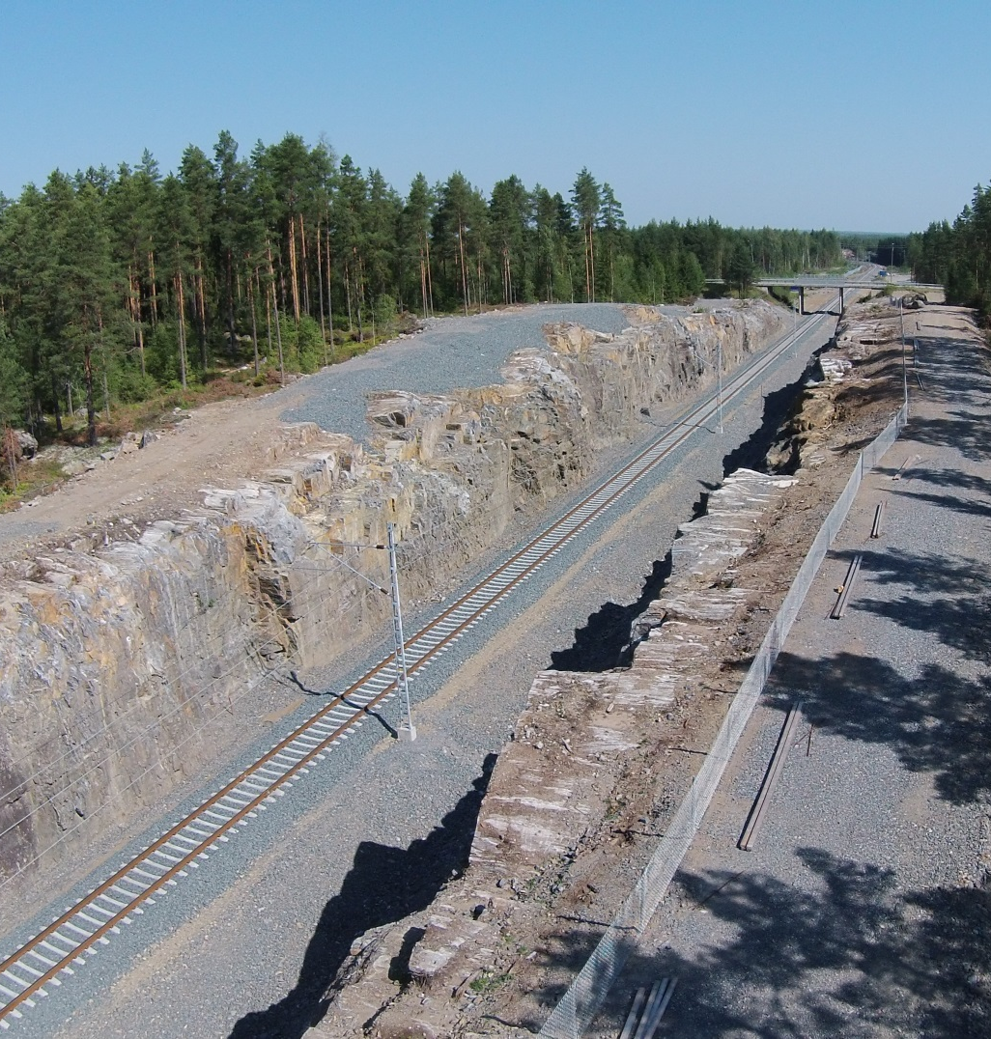
Expanding a rock cutting 20 000 m³

Slide 13
Common goals
Indicator | Poor performace | Minimum conditions of satisfaction | Outstanding performance | KRA results | KRA score
Passenger train punctuality [%] | 70 | 85-90 | 98 | 99,65 | 26
Freight train punctuality [%] | 70 | 85-90 | 98 | 99,93 | 9
Project completion date | 31.5.2016 | 31.5.2015 | 28.2.2015 | 28.2.2015 | 20
Railroad safety defects | 25 | 6-10 | 0 | 2,5 | 5
Worksite safety level [%] | 75 | 93 | 100 | 95,8 | 7
Accident frequency | 100 | 18 | 0 | 6,2 | 12
Tot. 79
-100
0
79
+100
Value for money

Slide 14
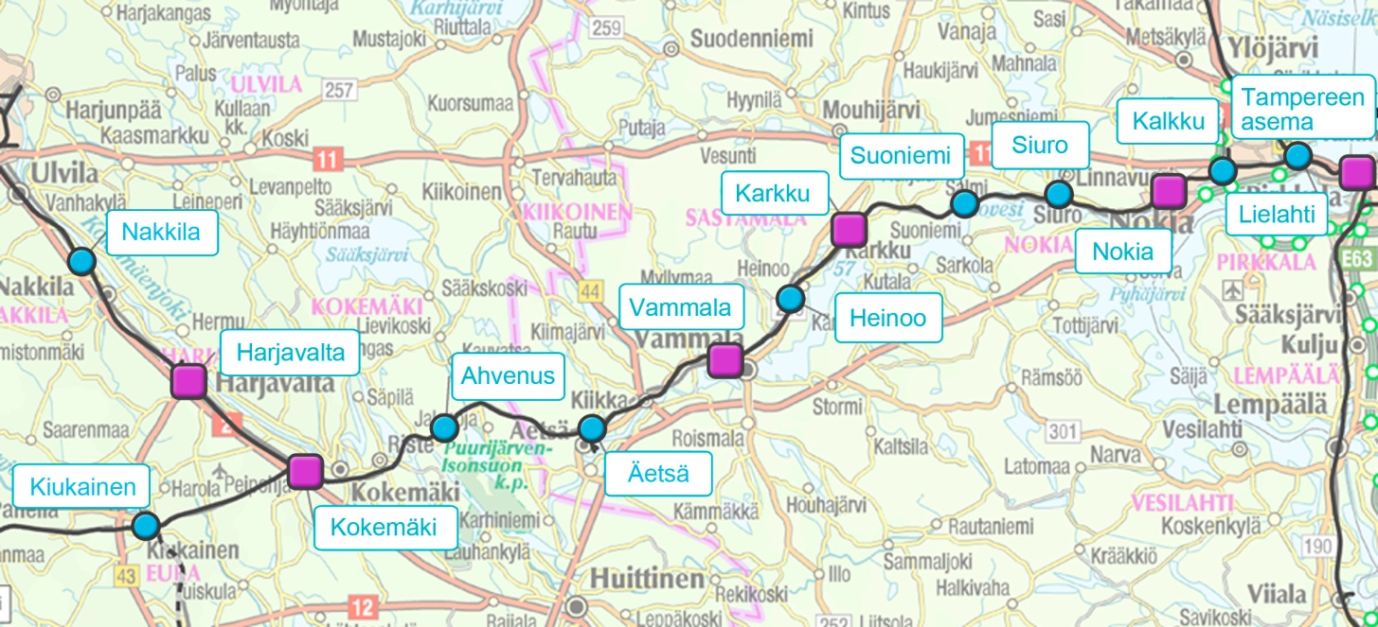
Usability of the railway during the alliance
27 000 trains passed the project area during three years of construction. Only 42 of these were late or cancelled because of the construction works.
Punctuality of the train traffic considering the effect of the construction works:
Freight traffic
99,93%
Passenger traffic
99,65%
Coordination between rail traffic and the construction works has been excellent

Slide 15
Safety as a key result area
Safety has been on very high level throughout the project
Alliance has been able to create processes for safety, that work as a natural part of everyday work
A total of 12 000 notes on weekly safety level measurings
Safety level at the work site 95,8%
Total hours of work: 640 000 h
4 accidents, in which only 19 man-days were lost
Accident frequency 6,2
3 railroad safety defects:
  Communication between the worksite and traffic control
  Securing the road traffic at level crossing
  Working in safety device premises without a permission
  Railroad safety on a good level

Slide 16
Outcomes of the commercial model
Actual outturn cost prediction at the end of the construction period: 80,0 M€
Forecast:
Gain +7,0 M€
Palkkio korvattaville
kustannuksille
Fee for project
specific costs
Goals are achieved and the success of the project can be well demonstrated
12%/25,6%
Projektikohtaiset
yhteiskustannukset
Risks
Owner´s costs
Palveluntuottajan
korvattavat
kustannukset
Owner has increased the project
scope with 4,2 M€ gained during
the alliance
Direct project costs
for non-owner
participant
Project costs
71,5 M€

Slide 17
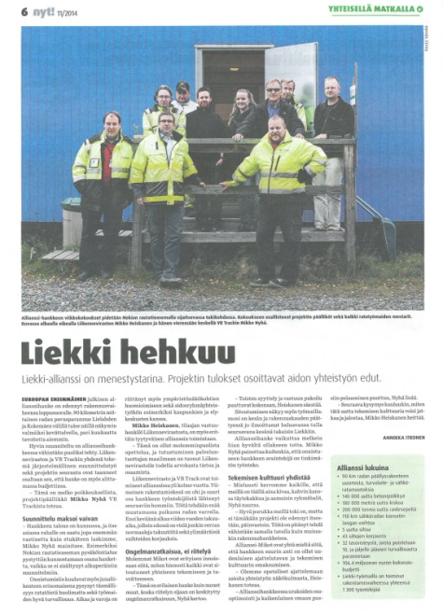
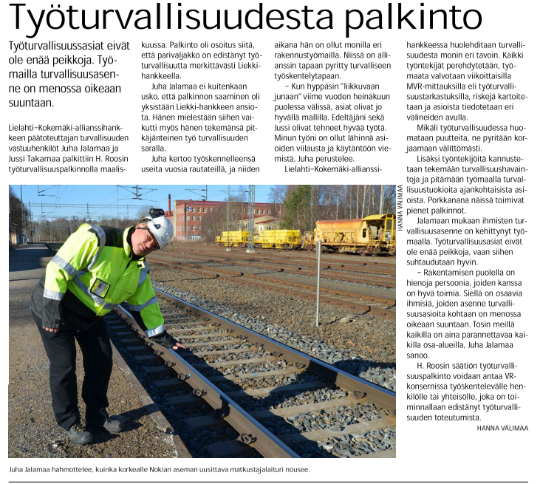
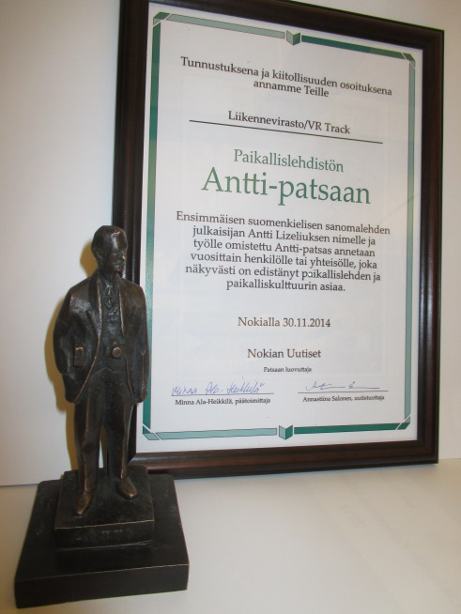
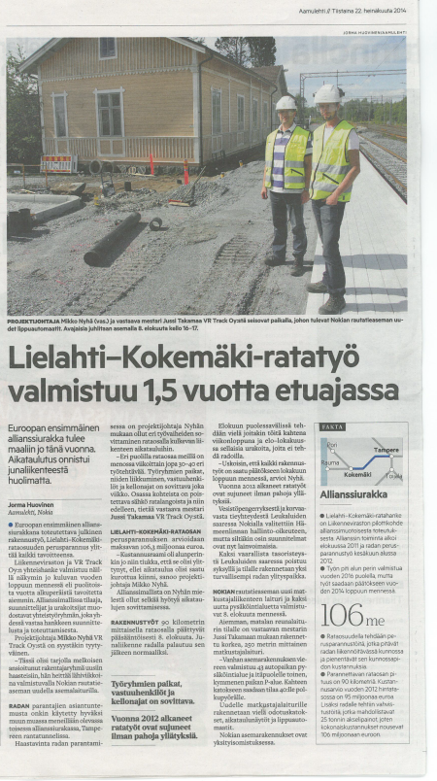
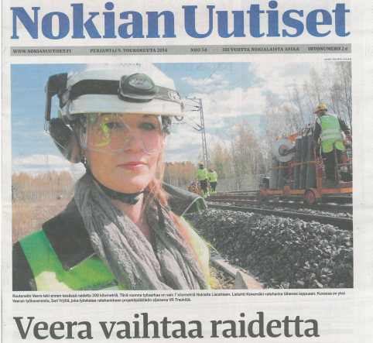
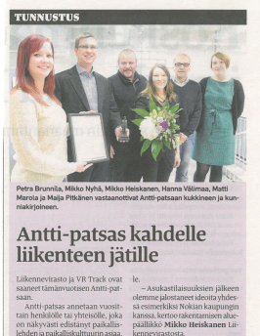
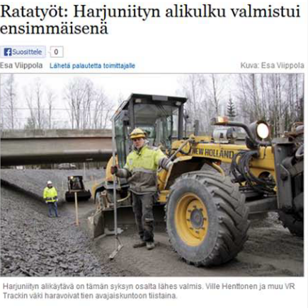
Positive publicity is part of the success

Slide 18

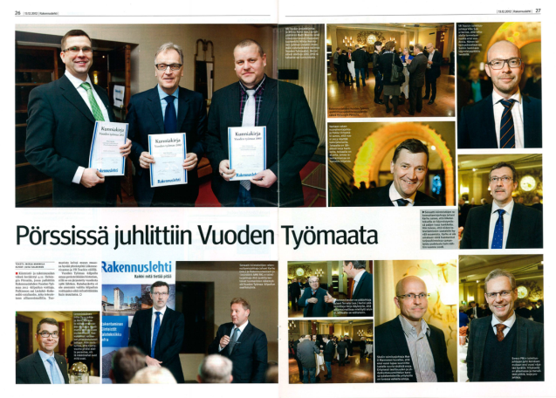
Work site of the year in 2012 !

Slide 19
IPD-Projects in Finland: 23 projects, total worth of 1,2 billion €
Source: Vison Alliance Partners Oy, Lauri Merikalliio

Slide 20
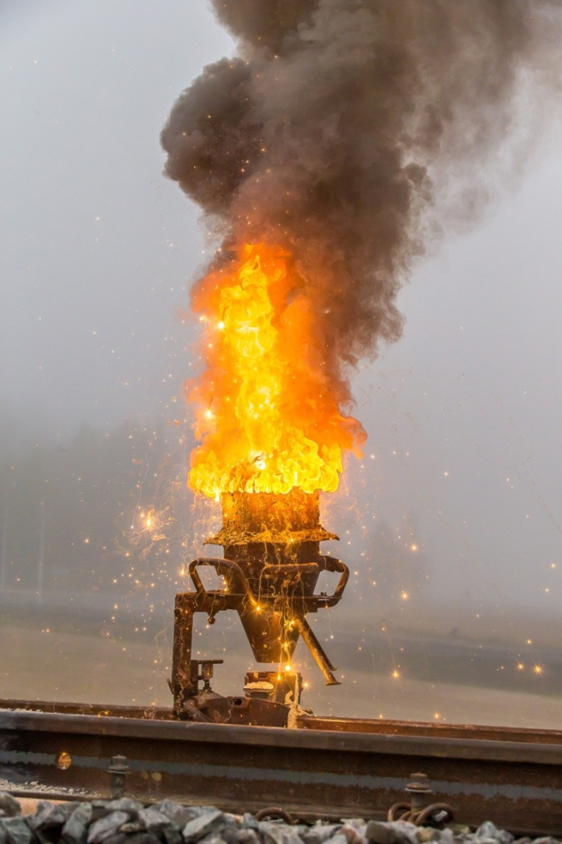
More information on the project:
liikennevirasto.fi/lielahti-kokemaki
Alliance project manager:
Mikko Nyhä, VR Track
p. 040 863 0450
mikko.nyha@vr.fi
Mikko A. Heiskanen, FTA
p. 029 534 3808
mikko.heiskanen@liikennevirasto.fi

